Slide 1
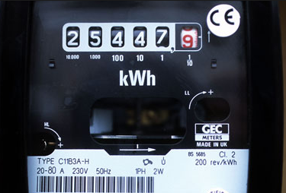
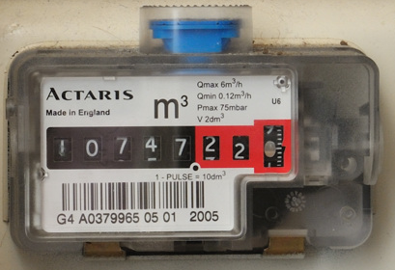
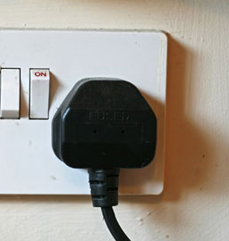
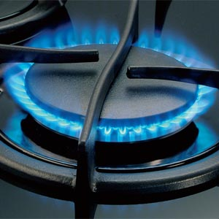
Reading Meters
When you own or rent a house, it will have meters, like the ones shown, in it somewhere.
What do these meters measure? Can you take their readings?
Electricity
Twenty five thousand, four hundred and forty seven point nine kilowatt hours
Gas
Ten thousand, seven hundred and forty seven point two two cubic metres

Slide 2
Reading Meters
To understand how much electricity you have used, you need to compare your old meter reading with your new meter reading.
Simply find the difference between the two readings.
How much electricity has this house used?
Old reading
3
4
7
8
1
2
52092.9 – 34781.2
= 17311.7 kWh
New reading
5
2
0
9
2
9
Readings are usually truncated to the nearest whole number:
52092 – 34781 = 17311 kWh

