Slide 1
What is the definition of average?
There are three types of average.
An average gives us an idea of the typical value of a set of data.
The mode
The most common value.
The middle value once you have put the data in order.
The median
The mean
The total shared out equally between how many values there are.

Slide 2
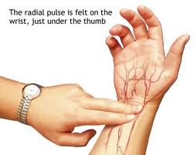
Physical Education
5 students took their resting heart rates.
What was the mode, median and mean heart rate?
81
72
76
63
63
Which average do you think represents the typical heart rate of the students best?
63
63
72
76
81
Mode = 63
Median = 72
Mean = (63+63+72+76+81) ÷ 5
= 355 ÷ 5
= 71

