Slide 1
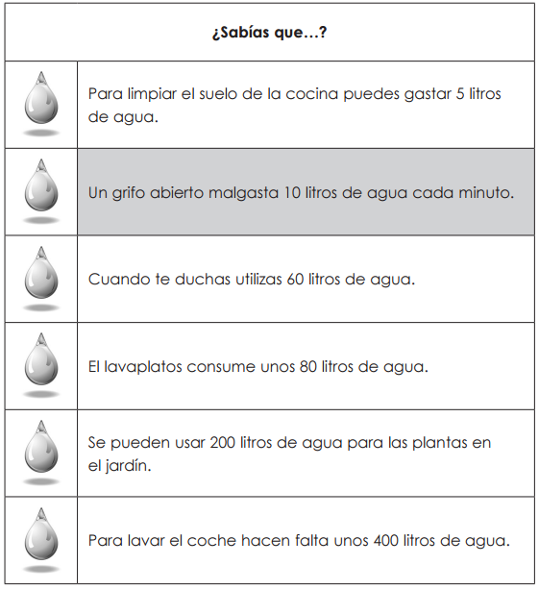
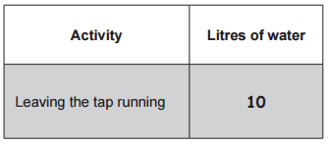
GCSE Subject Area – MFL - Spanish
400
60
200
If you don’t know the vocabulary, just think. Which process will use the greatest quantity of water?
AQA June 2015 Reading

Slide 2
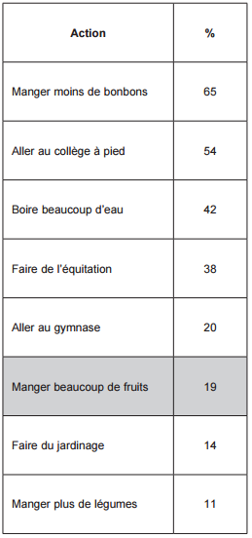
GCSE Subject Area – MFL - French
One hundred schoolchildren were asked what they do to keep healthy.
This table shows the results.
What percentage of children do the following?
If you don’t know the vocabulary, just think.
Which ways of staying healthy are likely to be more popular with children in France?
38
14
54
AQA June 2015 Reading

