Slide 1
How many of these can you unjumble to make the names of different types of charts and graphs?
C R A B H A R T
A S H T I G R O M
T I E P A R C H
T O X P L O B
T G S R A R C P T E A H
R A I L B P E H G A N R
E A V G M I N R D N A
T P O A C M I G R
R I A E L G H N P
C H A U E R D B L A R T

Slide 2
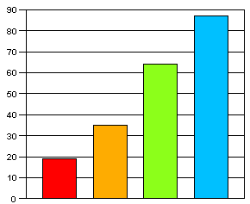
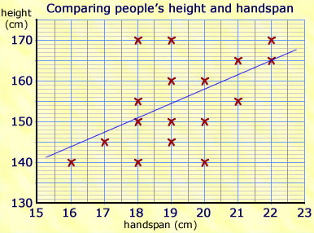
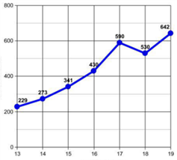
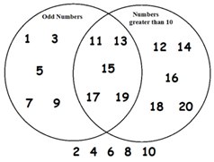
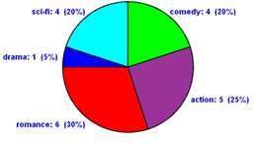
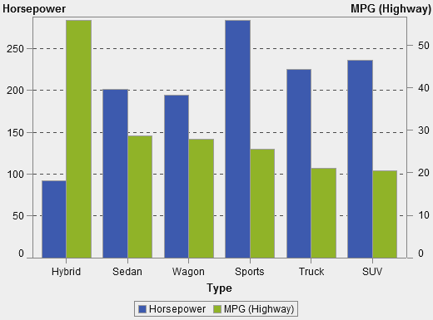
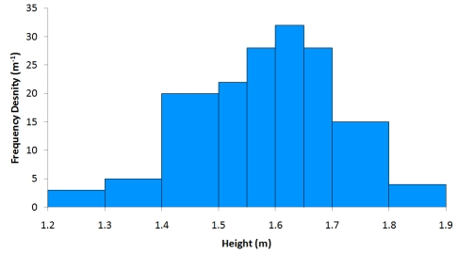
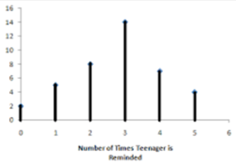
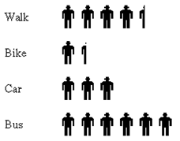
Need a hint?

Slide 3
How many of these can you unjumble to make the names of different types of charts and graphs?
C R A B H A R T
A S H T I G R O M
T I E P A R C H
T O X P L O B
T G S R A R C P T E A H
R A I L B P E H G A N R
E A V G M I N R D N A
T P O A C M I G R
R I A E L G H N P
C H A U E R D B L A R T

