Slide 1
Polygons
A polygon is a 2D shape with straight sides.
Polygons surround us everywhere.
How many of the polygons on the following slides can you name?

Slide 2
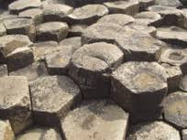
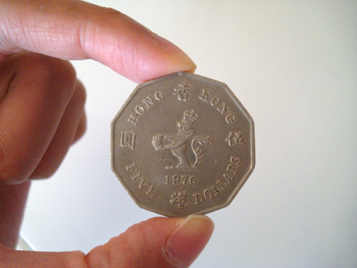
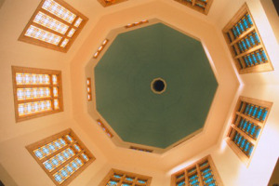
HEXAGON (6 sides)
DECAGON (10 sides)
Giants’ Causeway, Ireland
$5 coin, Hong Kong
OCTAGON (8 sides)
NONAGON (9 sides)
Stop sign
Bahai House of Worship, Uganda

Slide 3
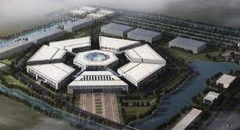
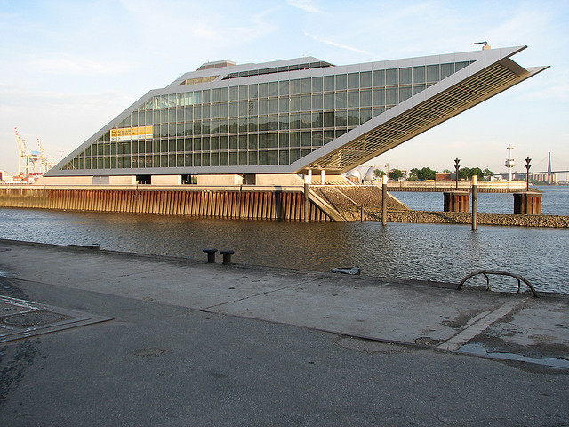
TRAPEZIUM (4 sides)
HEPTAGON (7 sides)
RHOMBUS (4 sides)
ChinaBio laboratory, China
Brazilian national flag
PENTAGON (5 sides)
PARALLELOGRAM (4 sides)
“The __________”, USA
Car park, Hamburg, Germany

